Slide 1
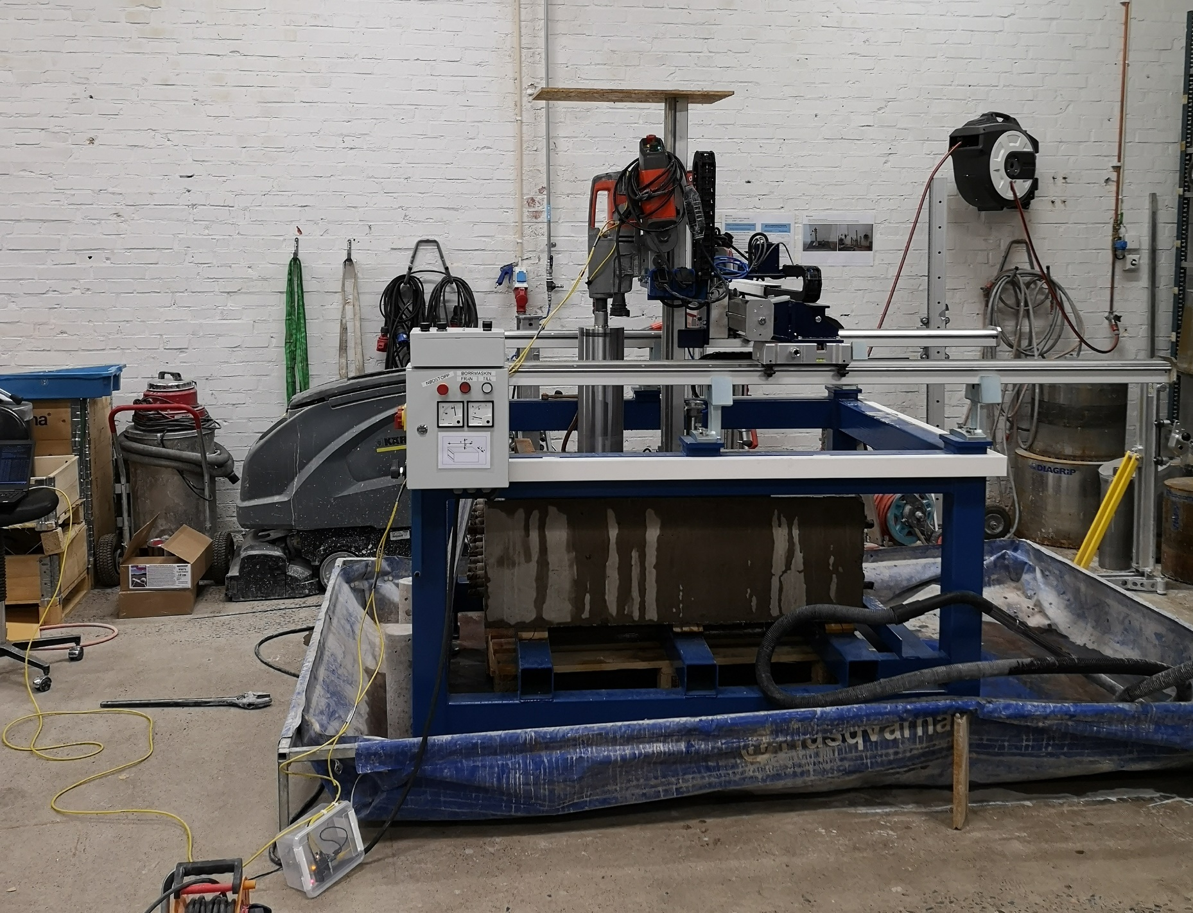
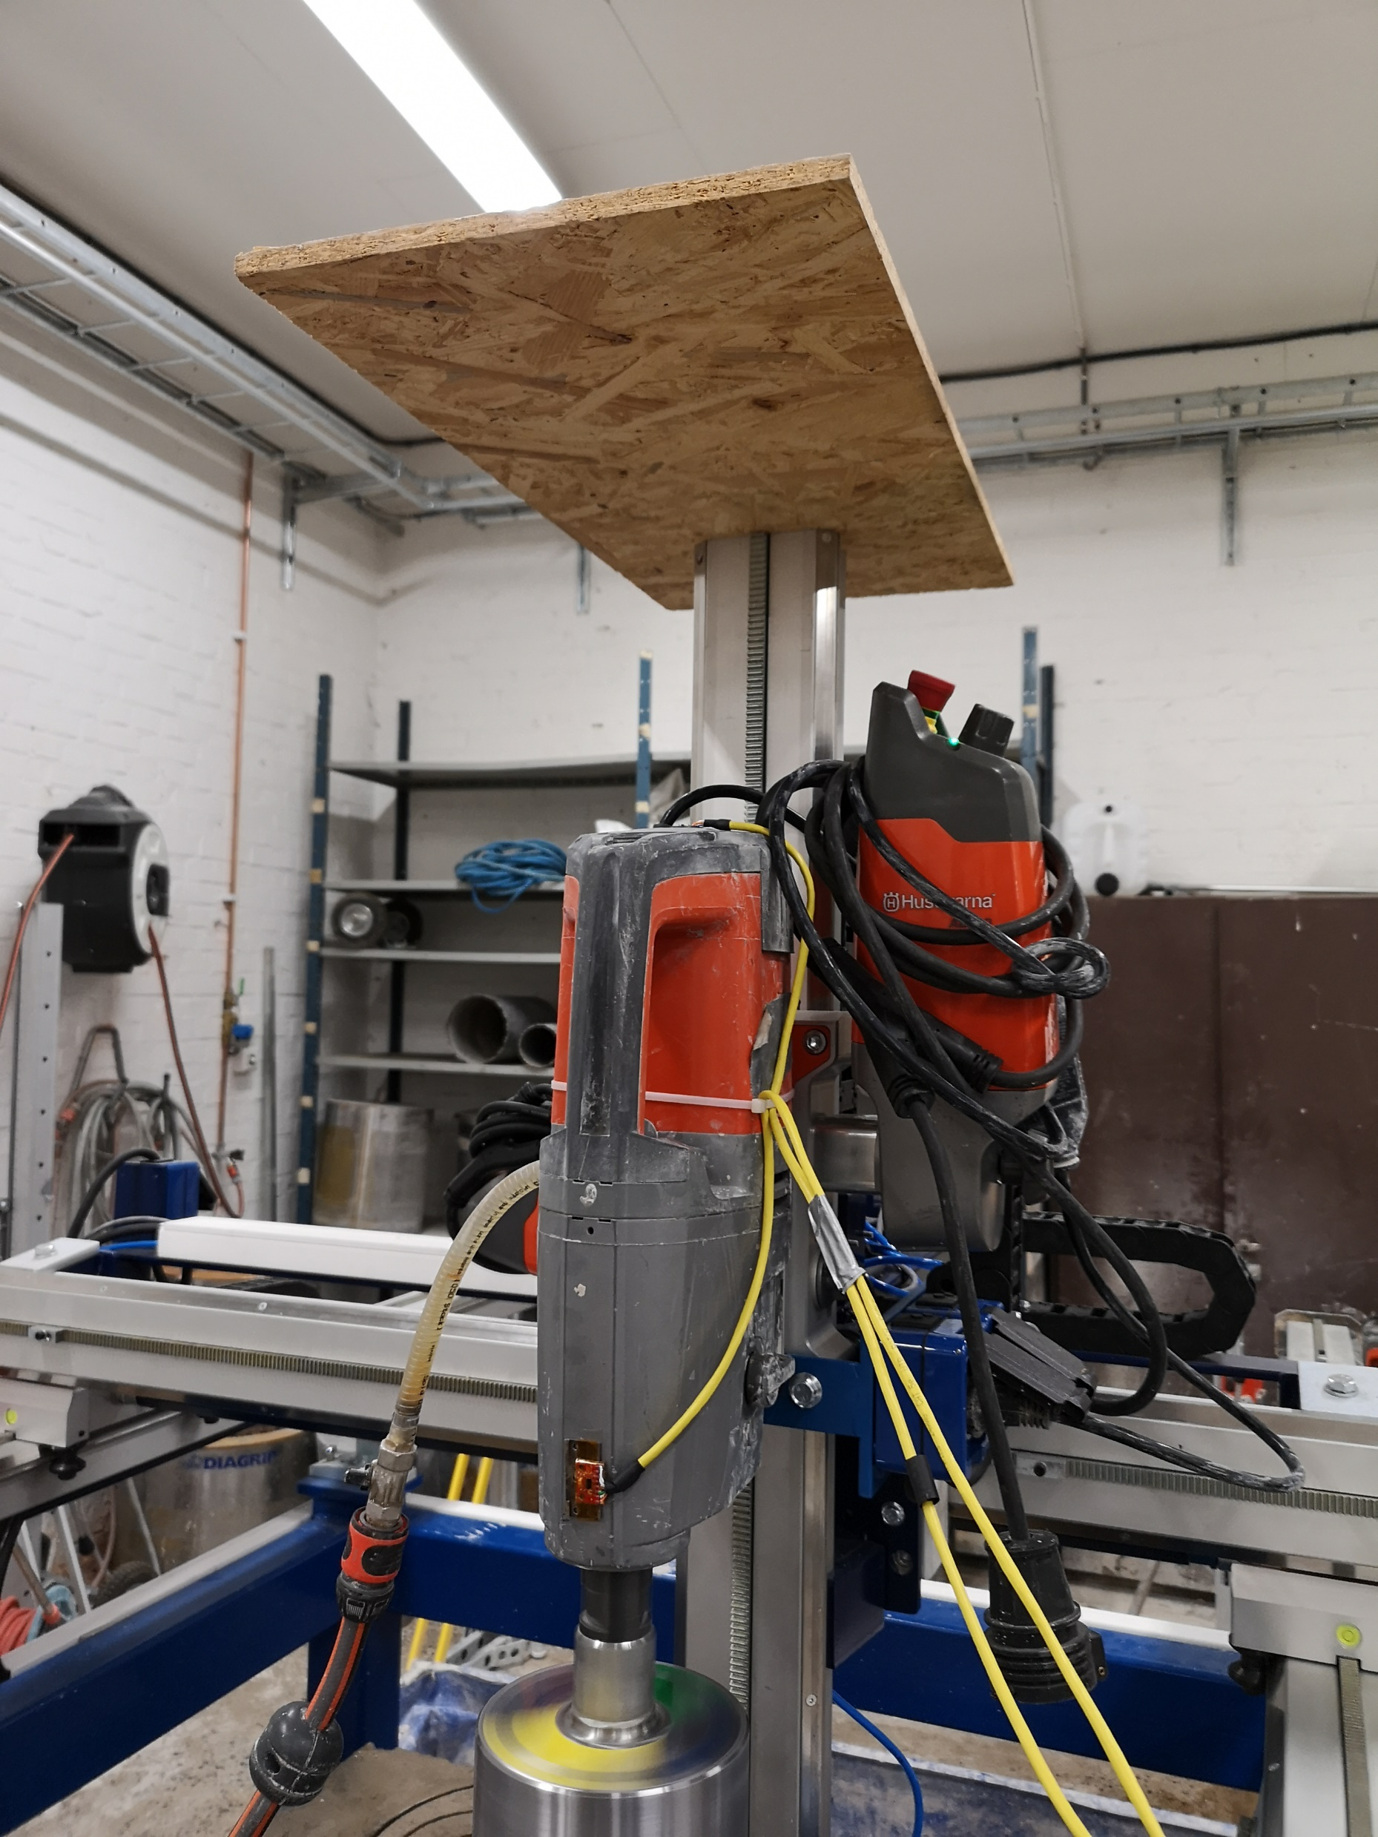
Drilling sessions 2018-12-3/4

Slide 2
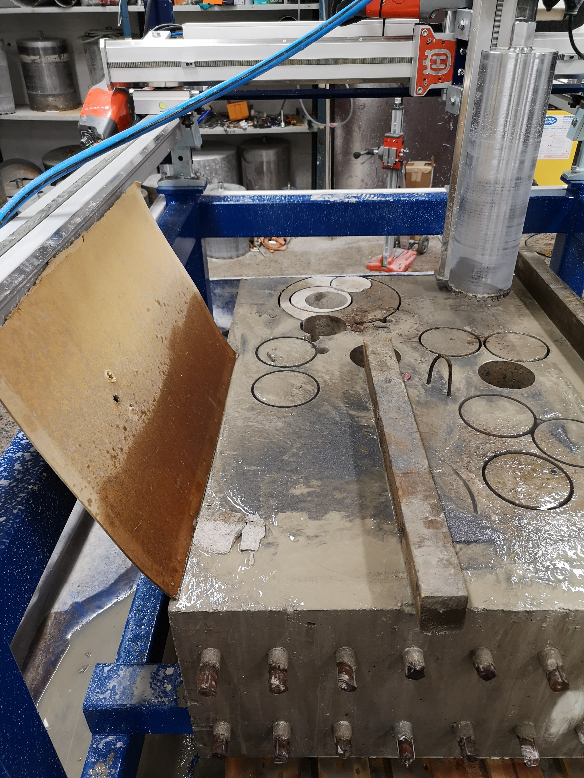
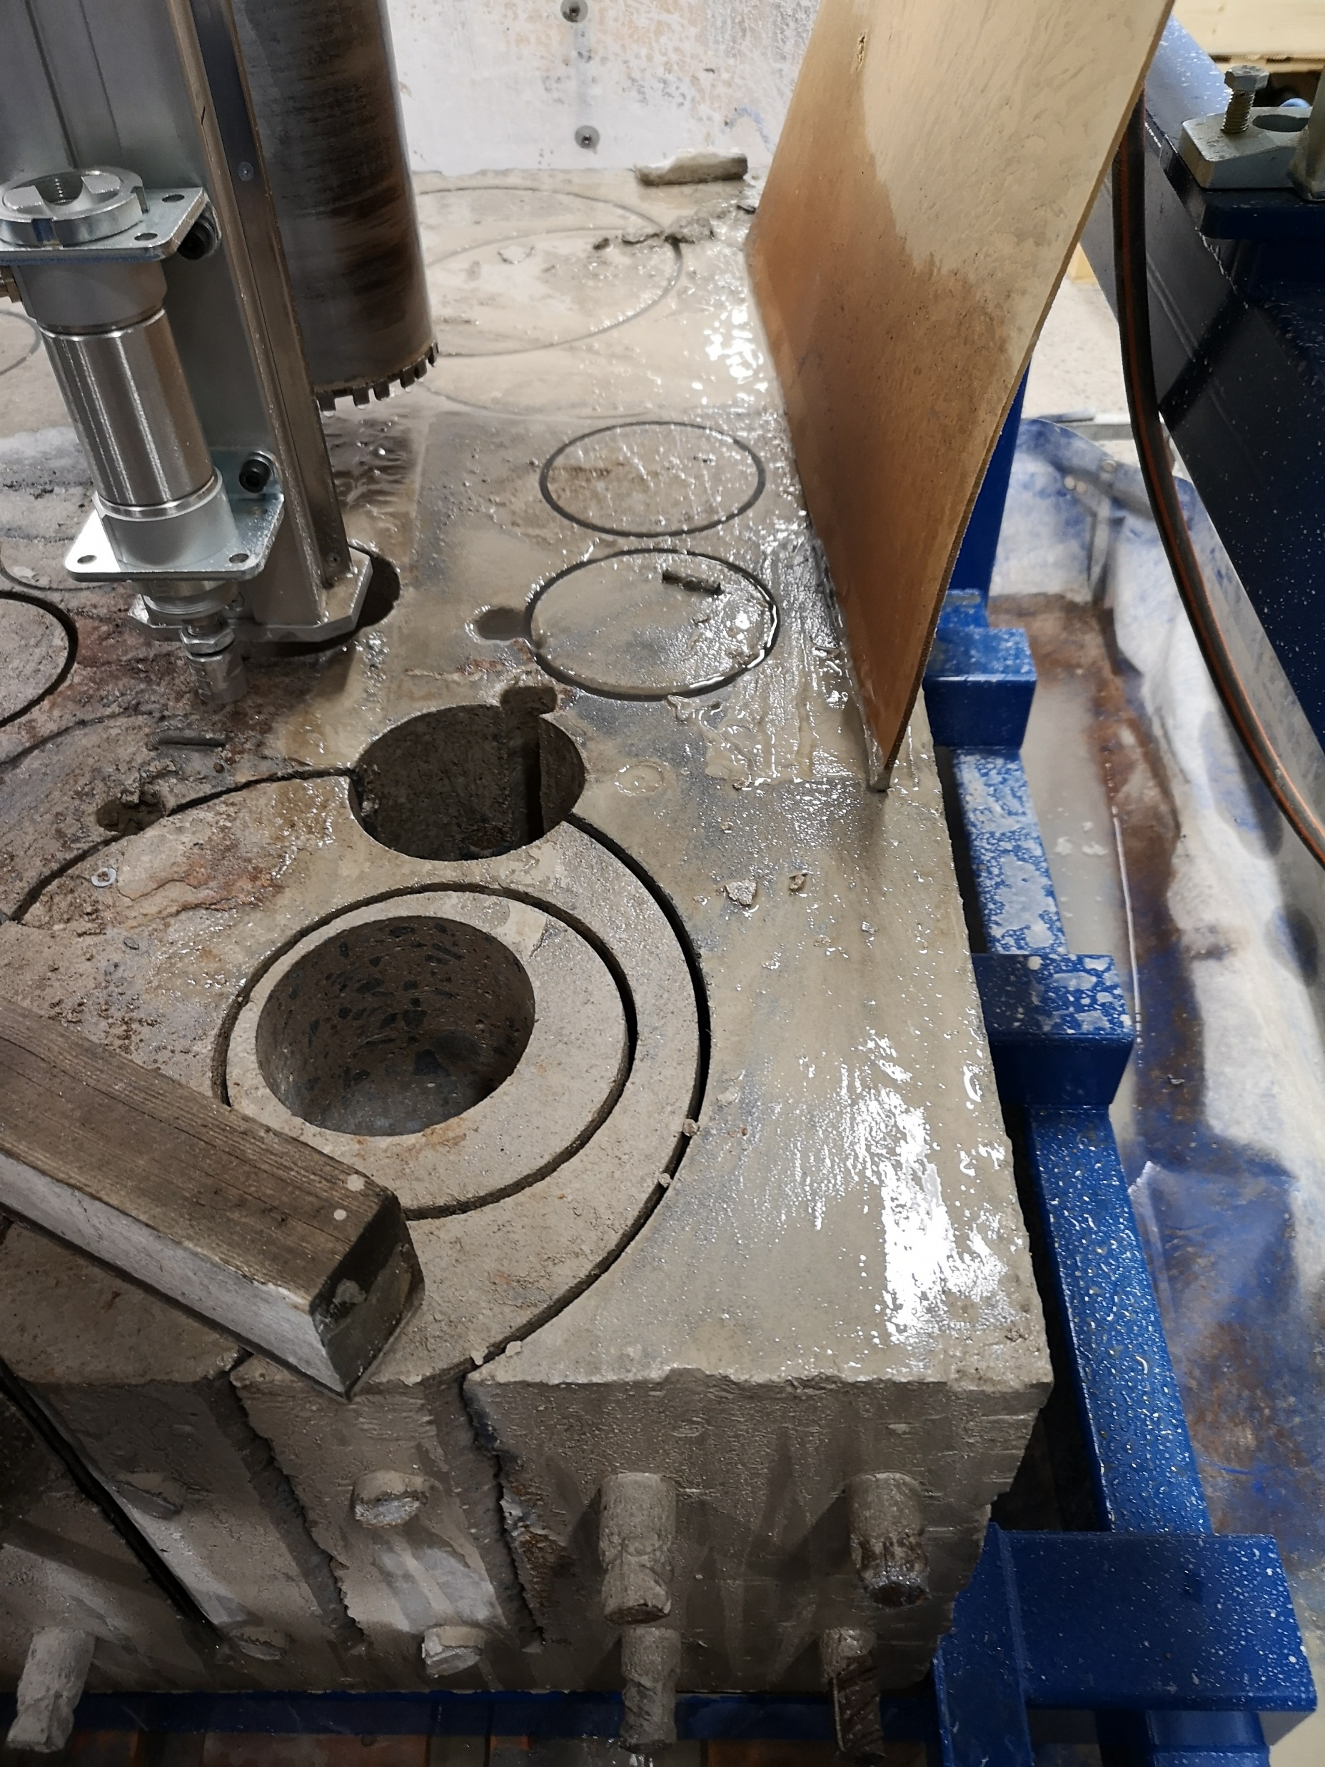
Drilling sessions 2018-12-3/4

Slide 3
Project schematic
Drill controller
Train server
TF controller
training
TF Backend
Mobile
App
TF controller
BLE server
Material classification
Accelerometer
Data acquisition
SPI
Depth
TF classifier
TF classifier
training
Waterflow
Data sources
Xbee
TF Backend
Saved data
Cloud
AD10
Live data
Data Saver
Classified data
AD10 current
Local
DB
Mount
Drill Current
Meeting 2019-02-14

